Slide 1
Student Engagement Monitoring
David Guetta Industries
BRYNN EHNI, RUIMING LIU, RANDALL LUECK, CARLO MENCARELLI, RAYDEN SORIANO IST-718, SECTION 2, SUMMER 2018

Slide 2


Who Are Oui?
Five students dedicated to empowering online learners through education technology.
Focus on marketing, admissions, student success, and outcomes support.
This Photo by Unknown Author is licensed under CC BY-NC-ND

Slide 3
Project Focus
This project aims to use facial recognition to identify the attendees in the recordings of the IST-718 Section 2 class, and to determine a student’s engagement using emotion recognition. The final product will be a comparative report using our in-house face and emotion recognition against a product out for purchase (i.e. Azure), and provide a cost-benefit analysis.

Slide 4
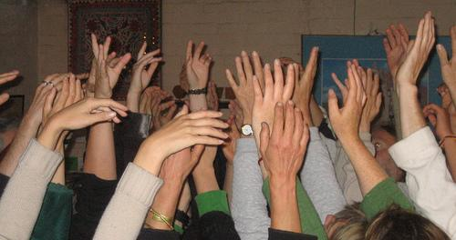
Previous Studies
In a report by Fredericks et al. entitled “School Engagement: Potential of the Concept, State of the Evidence,” current classroom monitors focus on three key aspects to ensure student engagement in the classroom.
Bored
Worried
Sad
Bad
Angry
Observational measures
Interested
Relaxed
Happy
Teacher reports on students
Student self-report questionnaires

Slide 5

Student Retention Variables
Attendance
Engagement
This Photo by Unknown Author is licensed under CC BY-NC

Slide 6
Data Collection - OBTAIN
Class Recordings
Photo capture every 5 seconds
Cohn-Kanade Emotion Database
CMU Face Images Dataset available through University of California Irving
Yale Facial Recognition Database

Slide 7
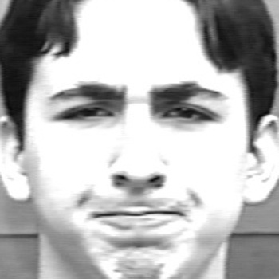
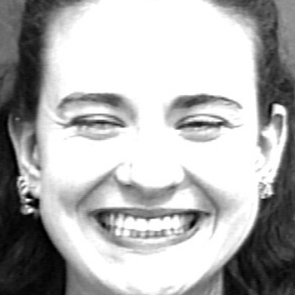

Munging and Cleaning - SCRUB
Cropped photos to just the face
Made each photo grayscale
Minimum size of 30x30 for each photo to be detected

Slide 8
Gaining Insight - EXPLORE
Emotion Recognition only had about 60% accuracy
Needed to add a new photo dataset
Photo data set was too small
Decided to add pupil recognition for added engagement metrics

Slide 9
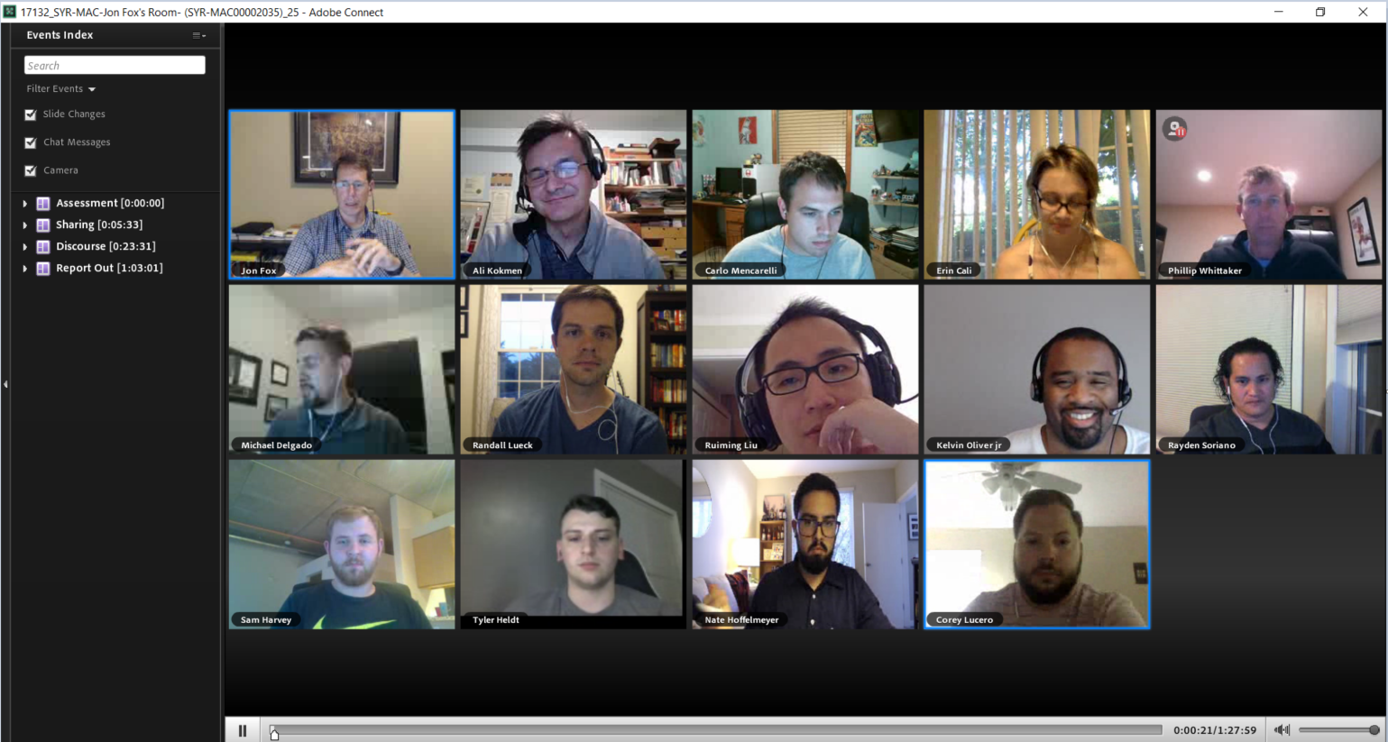
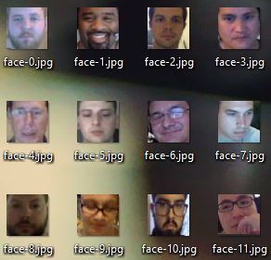
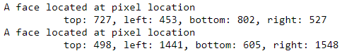
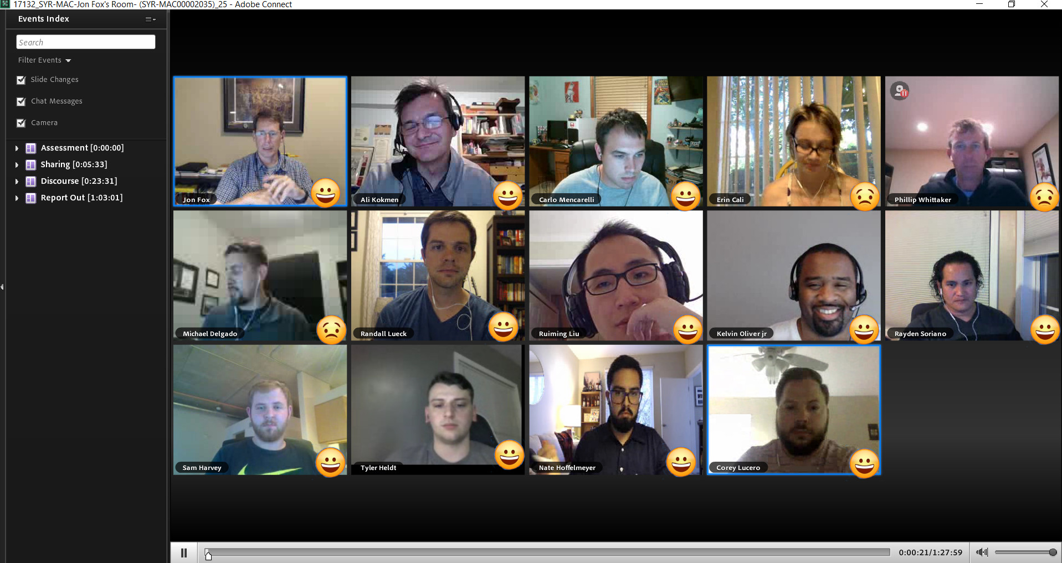
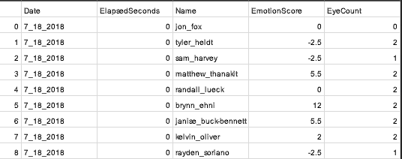
Emotion Recognition - MODEL
Built on OpenCV and face_recognition libraries
Emotion recognition views neutral or positive facial expression as engaged. Negative facial expression or failure to detect a face returns not engaged.
Find Faces
ID Faces
ID Emotion
Add Emotion
Record Data

Slide 10
DEMO

Slide 11
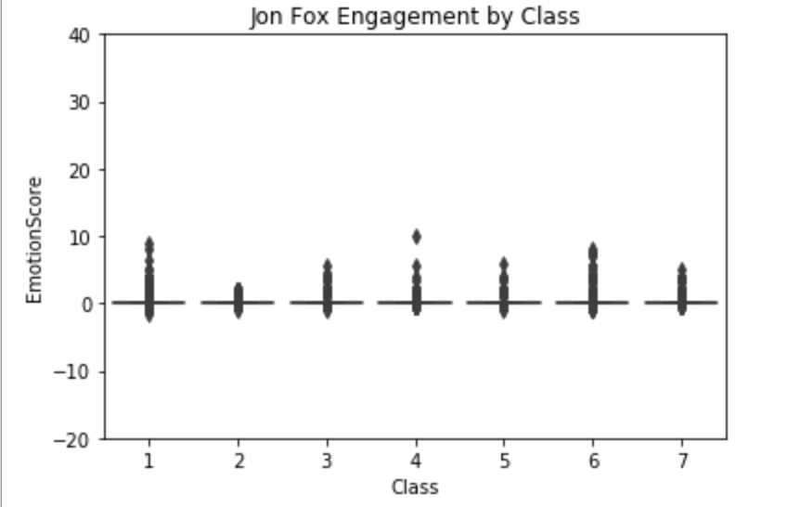
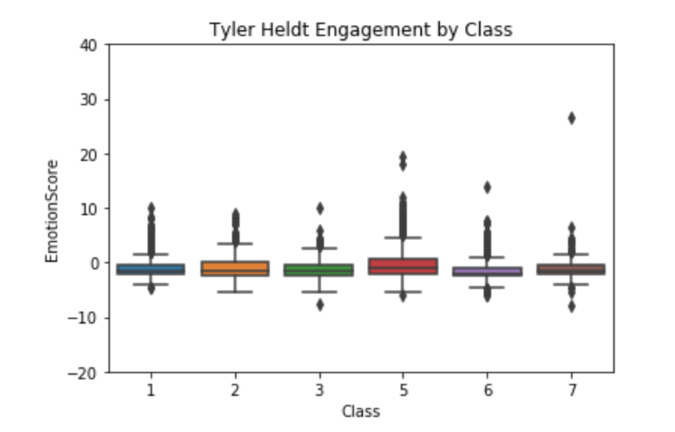
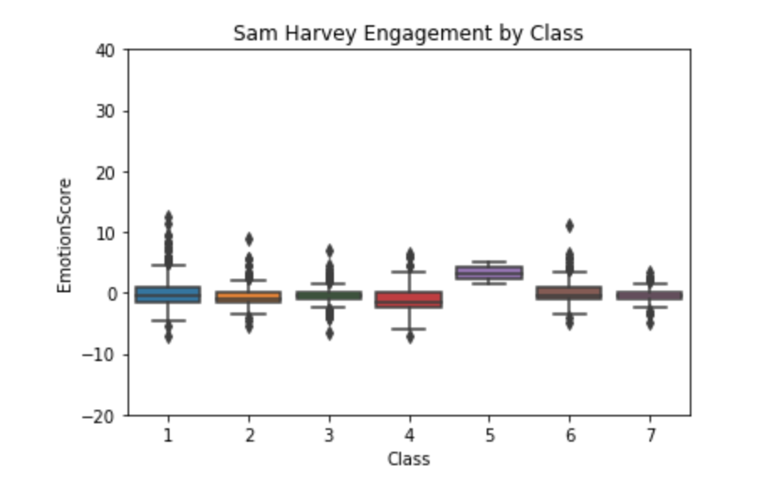
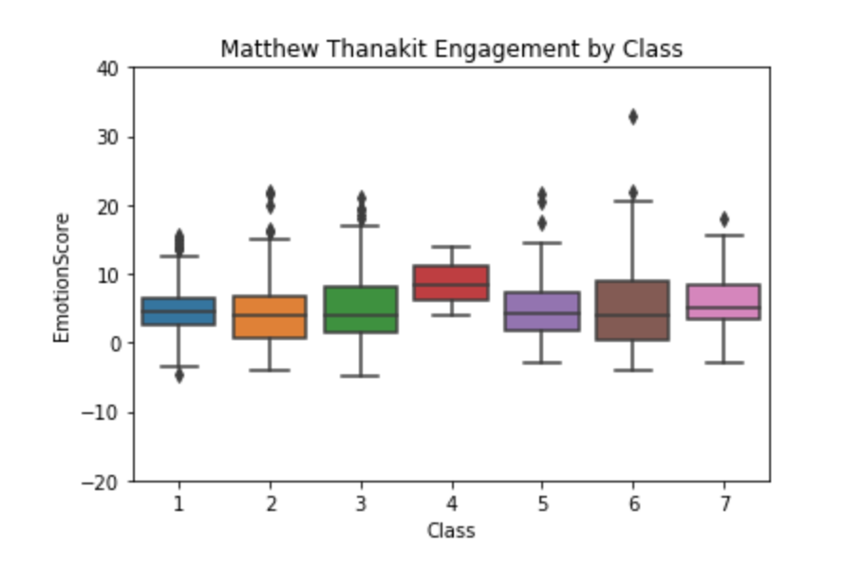
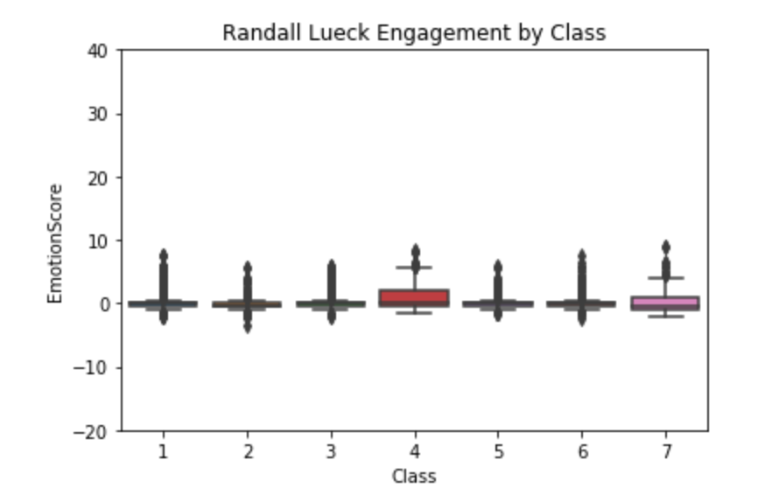
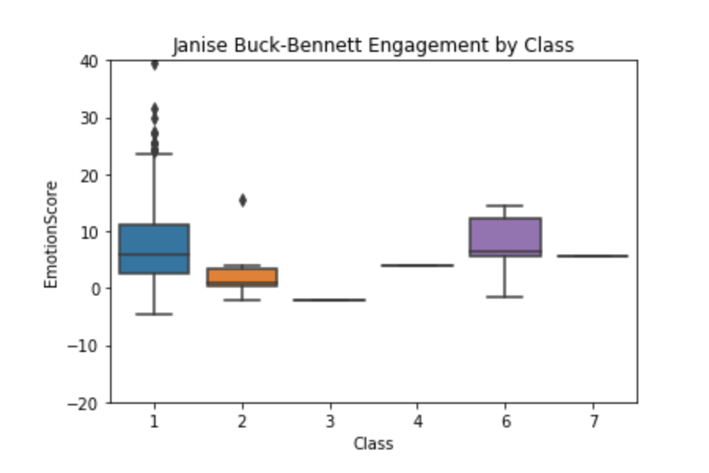
Student Engagement - INTERPRET

Slide 12
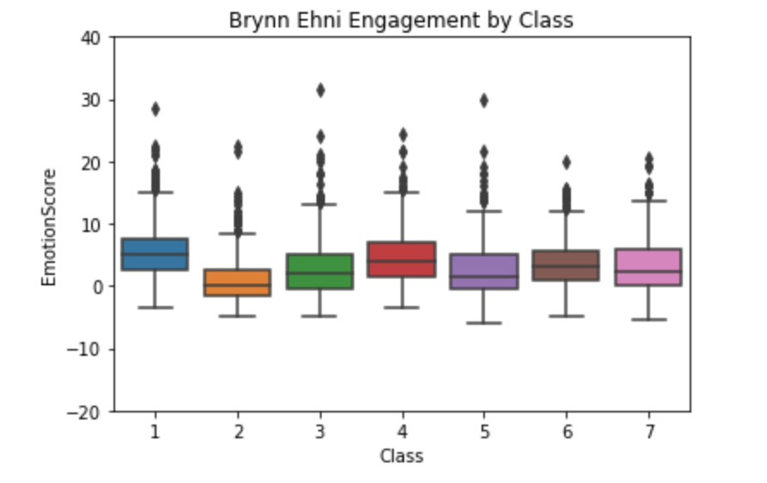
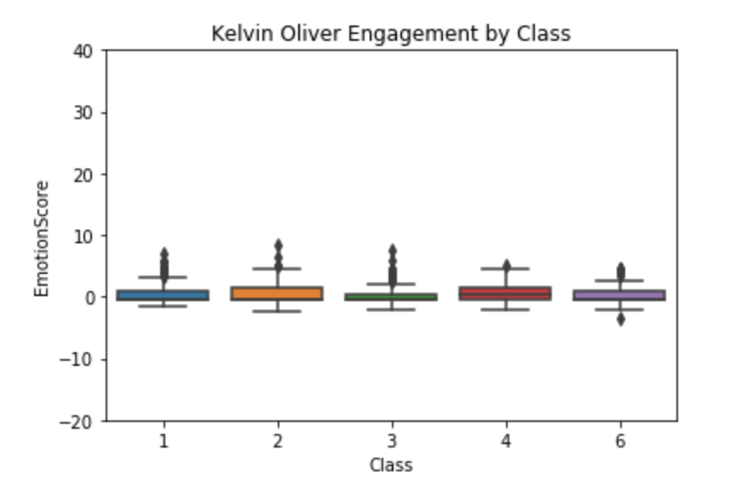
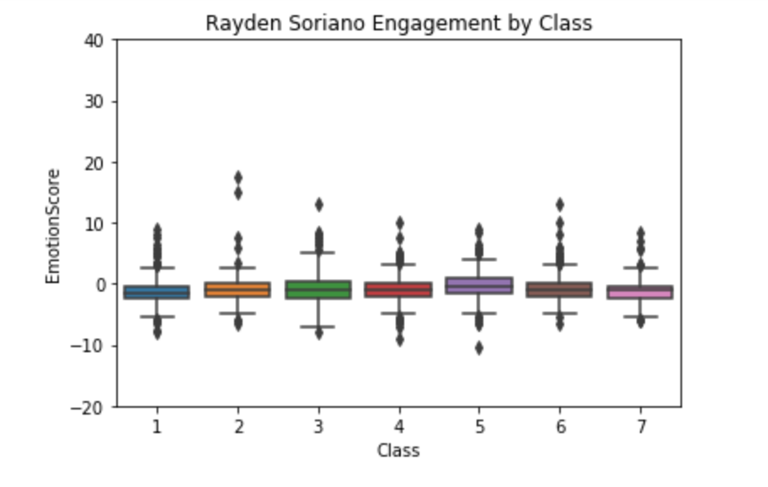
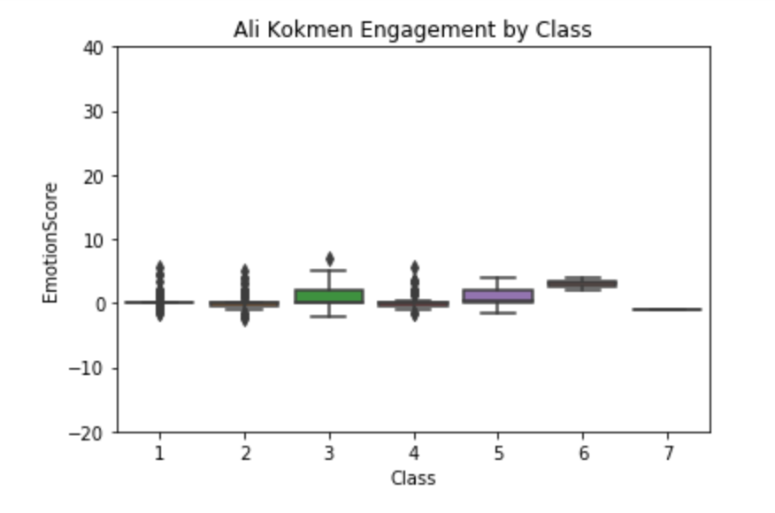
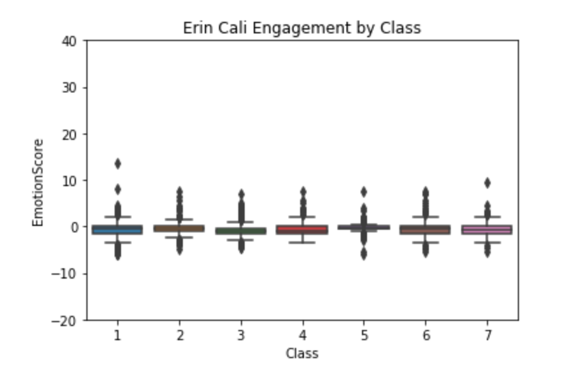
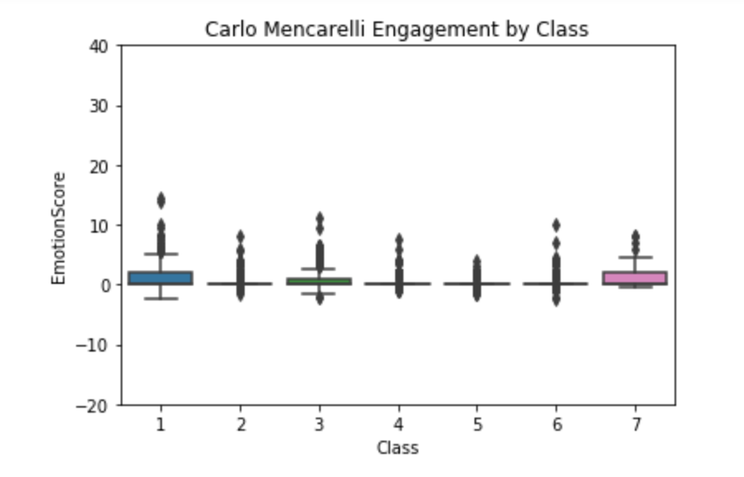
Student Engagement - INTERPRET

Slide 13
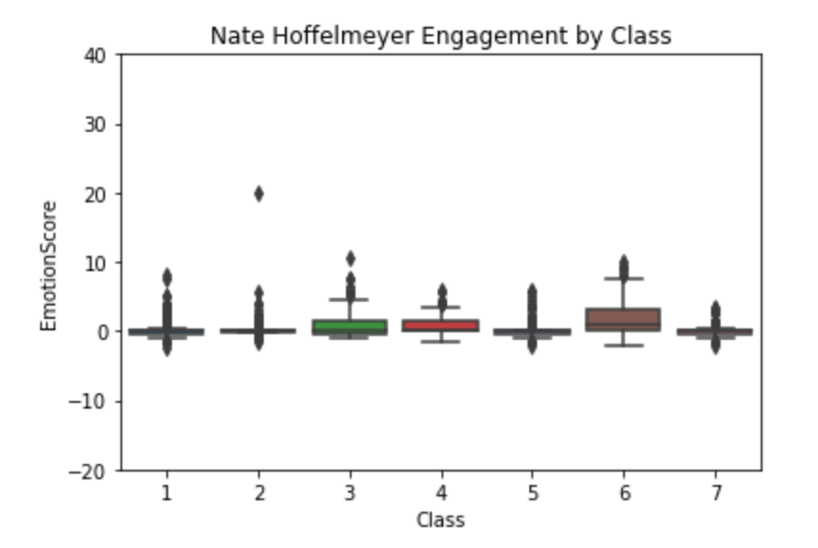
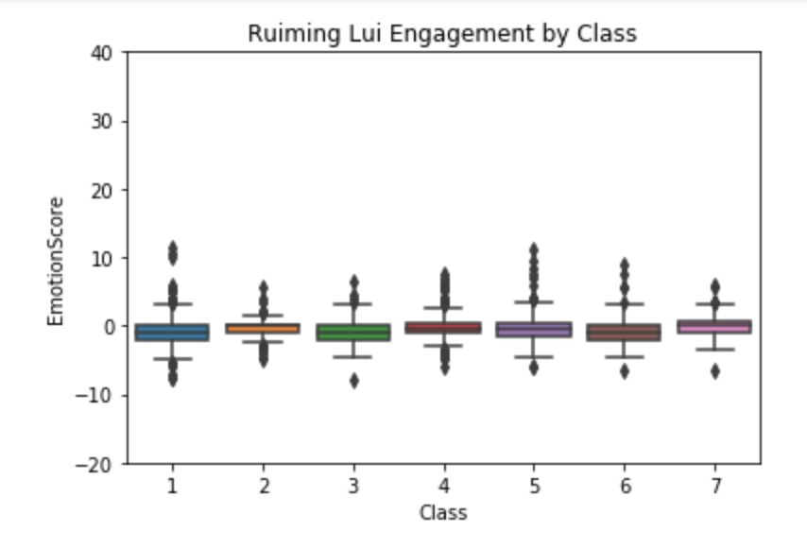
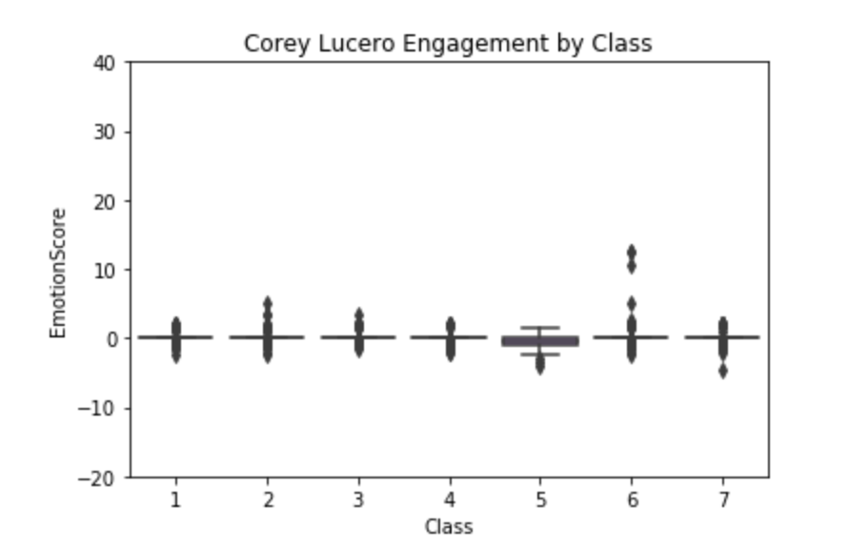
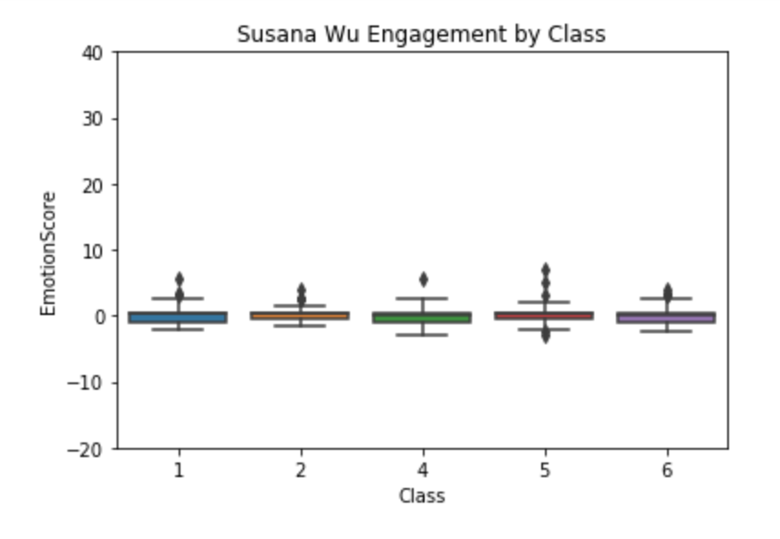
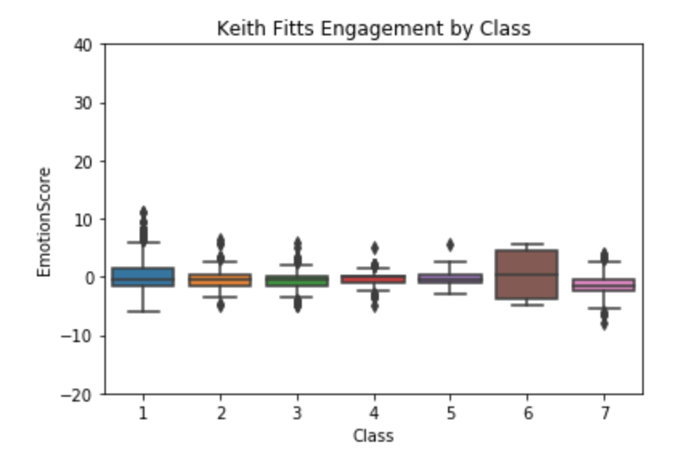
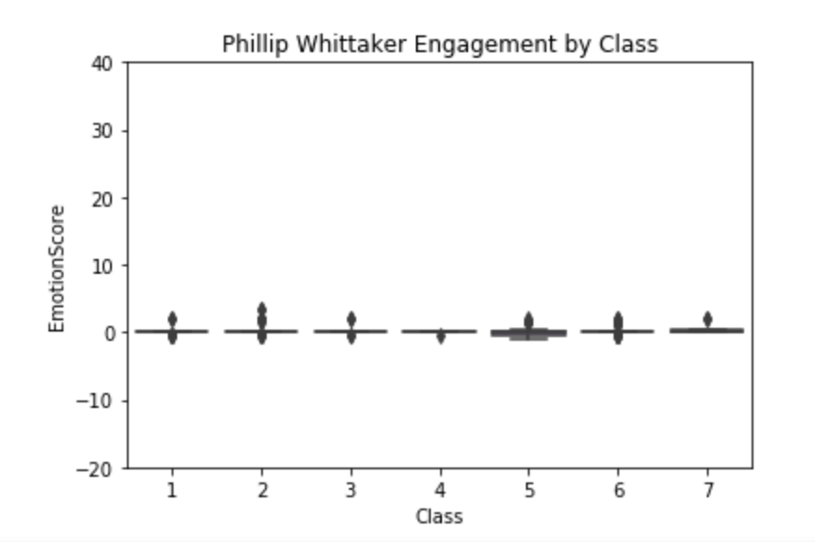
Student Engagement - INTERPRET

Slide 14
Cost Benefit Analysis
Company | Amazon | Microsoft | David Guetta Industries
Solution | Rekognition | Azure Face | Titanium
Price | Free trial on first year to analyze 1,000 minutes of video (real time and archived) per month. Prices vary by location. Likely between $.1 to $.15 per min of video (real time and archived) analyze. Storage is per 1000 faces metadata $.01 monthly. (Image has different prices) | Free - Up to 20 transactions per minute 30,000 transactions free per month Standard - Up to 10 transactions per second, $1 per 1,000 transactions, price decrease $.2 every 50,000,000 transactions till $.4. Storage $0.25 per 1,000 faces per month. (1 transaction is 1,000 images) | Free - the users need to setup own storage.
Key API | Labels (signs, flowers, tables etc). Text Detections (text in images). Faces recognition and analysis | Similar face search Face and emotion recognition against private repository | Face and emotion recognition Student class engagement analysis (currently online class only)

Slide 15
Going Forward
Gui / Integration with Adobe Connect or Zoom
Iris Detection
Voice Detection
Possible inflection detection
Recognize Paused Photo
Emojis

Slide 16
Sources
Recordings of IST-718 Section 2 class as the testing and training dataset.
Cohn-Kanade Emotion Database (http://www.consortium.ri.cmu.edu/ckagree/)
CMU Face Images Dataset available through University of California Irving (http://archive.ics.uci.edu/ml/datasets/cmu+face+images).
Fredericks, Jennifer A. et al. “School Engagement: Potential of the Concept, State of the Evidence.” Review of Educational Research, Vol. 74, No. 1 (Spring, 2004), pp. 59-109.
Yale Facial Recognition Database (http://vision.ucsd.edu/content/yale-face-database)
Paul Vangent, Emotion Recognition with Python (http://www.paulvangent.com/2016/04/01/emotion-recognition-with-python-opencv-and-a-face-dataset/)

